Slide 1
Project Life Cycle

Slide 2
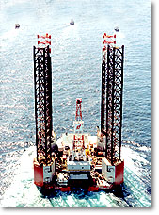

Project
A set of tasks carried out
To achieve the end result
As desired by the customer
Using an optimizing process

Slide 3






Project Life Cycle
Project Acquisition
Project Initiation
Project Planning
Project Execution
Project Delivery
Project Closure

Slide 4
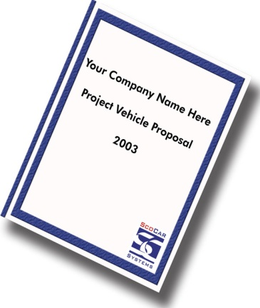
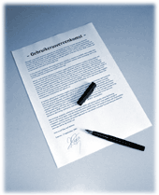
Project Acquisition
Deals with the activities before acquiring a project.
Processing Project Proposals
Contract Review

Slide 5


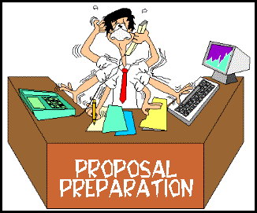



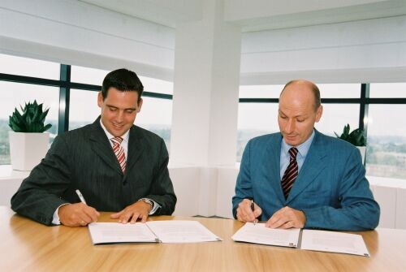

Project Acquisition
Customer
Proposal
Contract
Review
Signing
Project Win

Slide 6


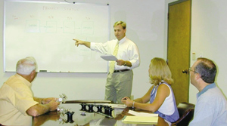
Project Initiation
RCC creates project id in SPR
Team formed with PL
N&S
VSS
CoRCC
Quantify
Finance
Kick Off Meeting
CS

Slide 7
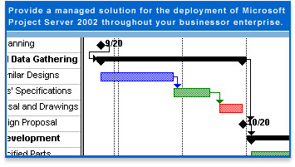
Project Planning
Project Estimation
Risk Management
Defect Prevention
Work Breakdown Structure
Identification of Roles & Responsibilities
Quality Assurance Plan
Configuration Management Plan
Metrics Plan

Slide 8
Project Execution
Task Allocation
Task Execution
Customer Comm.
Configuration Mgnt
SDLC
Project Meetings
Review/Inspection
Project Tracking
Metrics
Defect Prevention

Slide 9

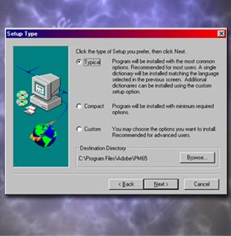

Project Delivery
Software Replication and Delivery
Software Installation
Acceptance

Slide 10

Project Closure
Release of Manpower
Release of Resources
Project Retrospective Meeting
Best Practices & Lessons Learnt
Taking Back Ups
Hand Over Project File

Slide 11
Thank you

